Slide 1
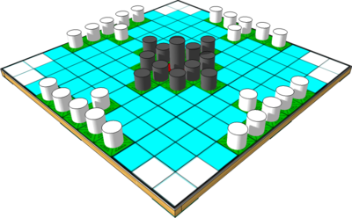
DATA SET | Online Gaming Anxiety Data
Gaming and its association with anxiety, life satisfaction
and social phobia

Slide 2

Content:
Introduction Background/Motivation Problem Statement Project Proposal Analysis Questions Dataset Description
Data Transformation
Data Analysis
Conclusion & Recommendation

Slide 3
Introduction
The Online Gaming Anxiety Data dataset consists of data collected as a part of a survey among gamers worldwide.
The questionnaire consists of several set of questions asked as part of a psychological study. Mainly to assess their anxiety, social phobia, and life satisfaction.
The original data was collated by Marian Sauter and Dejan Draschkow.

Slide 4

Background/Motivation
The gaming community has developed rapidly in the past decade, giving option for gamers to stream from the comfort of their homes and earn money through them, But this has given rise to a wide range of mental health issues as well.
Reference: https://www.ncbi.nlm.nih.gov/pmc/articles/PMC6138230/

Slide 5
Problem Statement
The general public does not have a clear understanding on how / when gaming affects mental health. There is a need for an analysis to keep people informed on some thresholds to help them achieve a reasonable balance between the virtual and real world.

Slide 6
Project Proposal
We aim to study the characteristics of gamers, to identify the association between gaming characteristics and mental health using the attributes related to social phobia, anxiety & depression with the help of Descriptive analysis.

Slide 7
Analysis Questions
Does the education of the participant make a difference with respect to the mental health related problems explored in this dataset among Gamers?
Does the Employment/Work of the participant make a difference with respect to the mental health related problems explored in this dataset among Gamers?
Does the Age of the participant make a difference with respect to the mental health related problems explored in this dataset among Gamers?
What is the relationship between Playstyle and the feeling of social phobia, anxiety & depression among gamers?
What is the relationship between hours a video game is played and the feeling of social phobia, anxiety & depression?

Slide 8
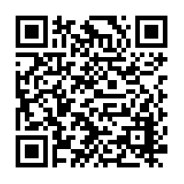
Dataset Description
The analysis will be based on “Online Gaming Anxiety Data” obtained from the kaggle dataset.
Here’s the dataset link:- https://www.kaggle.com/divyansh22/online-gaming-anxiety-data
The dataset include the data of online survey which was implemented on Google form with the participants of more than 13,000 - resided in above 100 different countries.

Slide 9
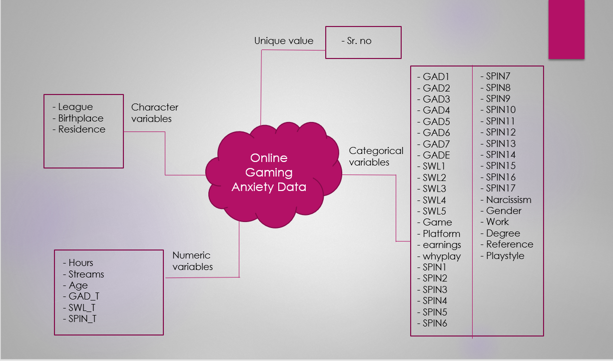
Data Description

Slide 10
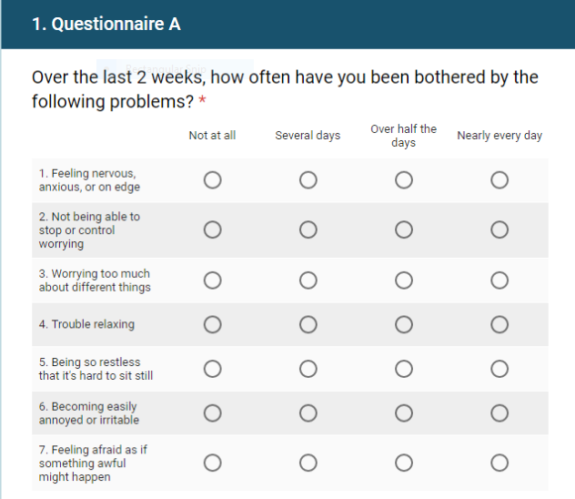
Generalized Anxiety Disorder – (GAD)
The GAD (Generalized Anxiety Disorder) variable or column was used to measure generalized anxiety.
The scale is comprised of seven questions which are designed to assess a participant’s health status.
Seven questions were described in the dataset as GAD1, GAD2, GAD3, GAD4, GAD5, GAD6, and GAD7 columns. In this, seven questions there total 4 options to choose.

Slide 11
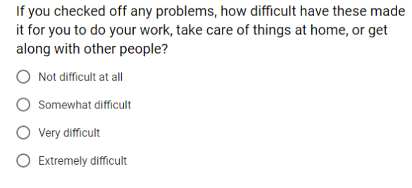
The GAD_T column represents the summed up scores of individual questions-answers up to a score of 0 (no anxiety) to 21 (severe anxiety). And the overall scores of 5, 10 and 15 represent cut-off scores for mild, moderate and severe anxiety disorder.
For, the GADE column following question was asked in the survey.
Satisfaction with Life – (SWL)
The SWL (The Satisfaction with Life) variable or column was used to measure life satisfaction.
Participants responded on the 5-questions scale of 7 options indicating their degree of agreement from “strongly disagree” to “strongly agree”.

Slide 12
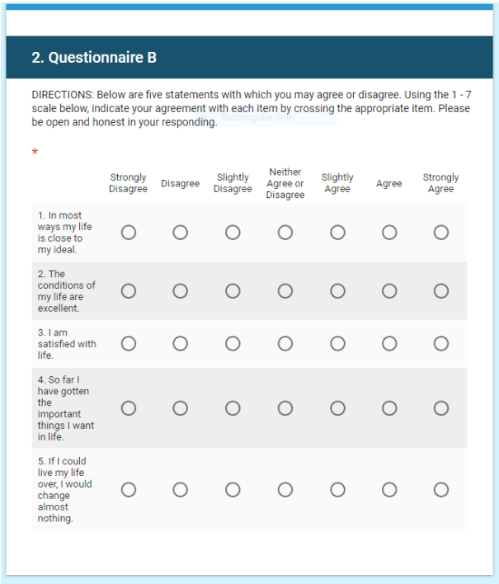
Five questions were described in the dataset as SWL1, SWL2, SWL3, SWL4, and SWL5 columns.
Following questions were asked in the SWL (The Satisfaction with Life) module.

Slide 13
This scale was designed to investigate subjective experience of well-being without respect to specific life domains such as health or employment status.
The SWL_T column represents the summed-up scores of individual questions-answers which were asked in SWL (The Satisfaction with Life) module.
Social Phobia Inventory - (SPIN)
The Social Phobia Inventory (SPIN) is a 17-item questionnaire for screening and measuring severity of Social Anxiety Disorder.
Social Phobia Inventory (SPIN) was developed. SPIN assess different aspects related to Social phobia – fear, avoidance, and physiologic symptoms.
It is suitable for adult population (18+). Main application is for measuring change following pharmacological treatment.
Example items:
I am afraid of people in authority
I am bothered by blushing in front of people
Parties and social events scare me
Reference link: https://www.psychtools.info/spin/

Slide 14
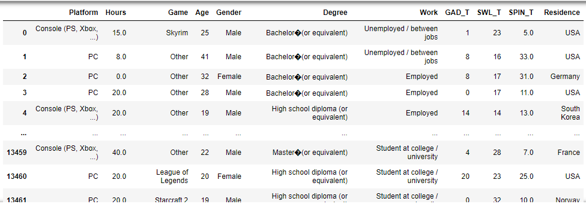
Exploratory Data Analysis
From the whole dataset we’ve separate the total 12 columns in which this analysis will be mainly focused on and assigned to the dataset called “data1”.
12 columns are: “Platform”, “Hours”, “Game”, “Age”, “Gender”, “Degree”, “Work”, “GAD_T”, “SWL_T”, “SPIN_T”, “Residence”, ”Playstyle“ .

Slide 15
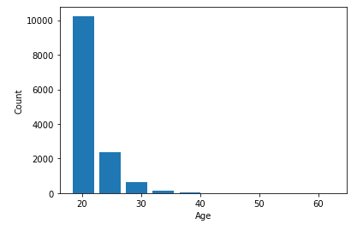
Visualizations of some individual variables to understand them better:
'Age' Variable:
Referencing to the histogram that is created above, we can conclude that it is a 'Unimodal' and 'Right-Skewed' distribution. So, from this graph we can clearly see that most of the respondents were in their 20’s.

Slide 16
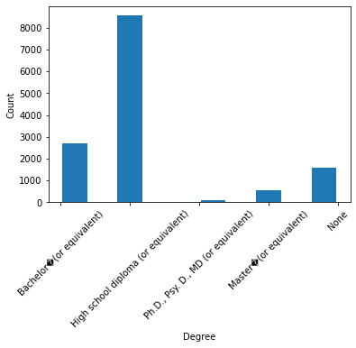
'Degree' variable:
From the above plot, it can be clearly seen that the High school Diploma holders or equivalent holds the highest count in terms of usage of the various gaming platforms and the Bachelors Degree holder holds the second highest position when compared with others.

Slide 17
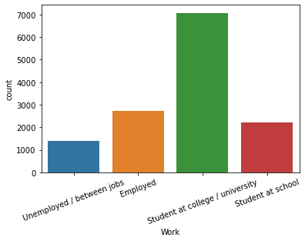
‘Work' variable:
From the above plot, it can be clearly seen that the “Student at college/university” work type people holds the highest count in terms of playing games than the other work types.

Slide 18
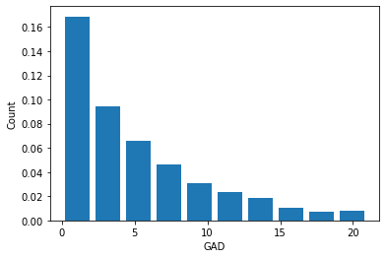
‘General Anxiety Disorder ( GAD_T )' variable:
We can see from the plot that this variable is 'Unimodal' and 'Right-Skewed' distribution.
From this above graph we can see that most of the values are distributed between 1 – 10.

Slide 19
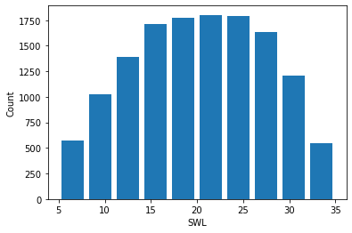
‘Satisfaction with Life ( SWL_T )' variable:
From the graph above we can see that SWL_T variable is normally distributed.
Most of the values are distributed between 10 to 28

Slide 20
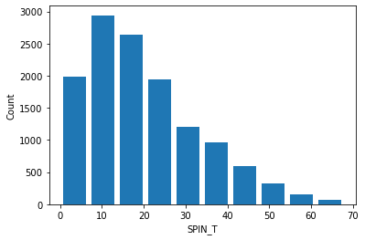
‘Social Phobia Inventory ( SPIN_T )' variable:
We can see from the plot that this variable is 'Unimodal' and 'Right-Skewed' distribution.
Majority of participants have received a score between 5 – 25.

Slide 21
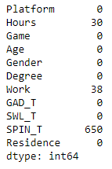
Identifying missing values
Missing values are observed in three columns:
1) Hours = 30
2) Work = 38
3) SPIN_T = 650

Slide 22
Data Cleaning and Transformation
We’ve removed the null values from three variables Hours ,Work ,SPIN_T using python code before doing the actual analysis.
In Data Transformation:-
The variable ‘Age’ had multiple values in it, so we have grouped it based on five type to get a better insight in the plot and named it as “Age_Group”.
Five different types of groups are: ‘18’, ‘19’, ‘20’, ‘21’, ‘22’, ‘22+’.
The variable 'Hours' had multiple values in it, so we have grouped it based on 6 intervals and named it as “Hours_Grouped”.
Six different intervals are: '0-10','11-15','16-20','21-25','26-30','30+’
The variable ‘Playstyle' had multiple values in it, so we have grouped it based on 4 intervals and named it as “Play_Style”.
Four different intervals are: “with real life friends” , “with strangers”, ”with online acquaintances or teammates”, “Others”

Slide 23
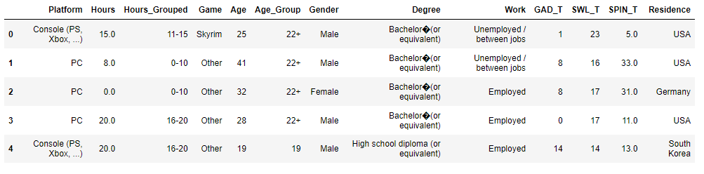
View of the table after transformation:
As we can see from the above picture that, we have included two new columns.
Also, we have performed data transformation on “Playstyle” variable.
‘Playstyle' variable had multiple values in it, so for the “Multiplayer” values -we have grouped it in three different types. As, ‘Multiplayer with real life friends‘ (Category), ‘Multiplayer with strangers‘ (Category) , ‘Multiplayer with online acquaintances or teammates‘ (Category).
We have filled ‘NA’ values with ‘Other’ value.

Slide 24
Data Analysis
Questions :-
Does the education of the participant make a difference with respect to the mental health related problems explored in this dataset among Gamers?
If you are looking for the short answer it is Yes, find below the plots that support this claim.
Education can be ordered using the following index from least to highest,
High School Diploma
Bachelors
Masters
Ph.D

Slide 25
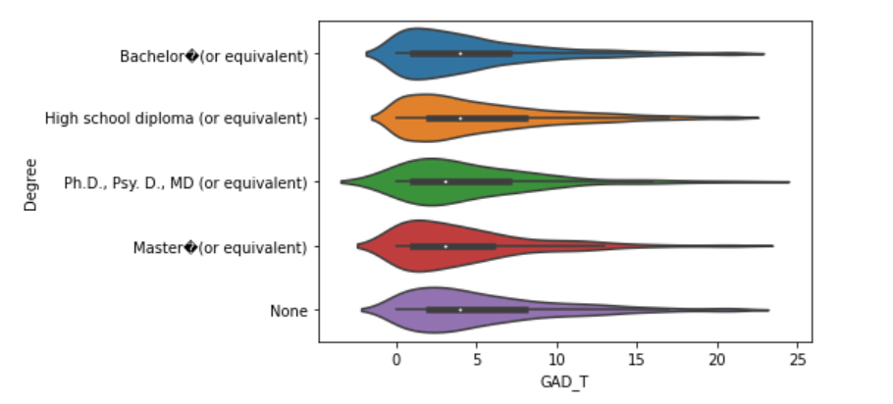
Education Vs Anxiety Severity (GAD - Test)
With respect to the GAD test, We can see that
A lower score in this test reflect to a lower Anxiety in life.
The highest median value seems to be for the High School and Bachelor level education, even though they look similar in this datapoint, the 25th and 75th percentile for the high school participants is higher than that of the Bachelor degree holders. Meaning people with a bachelor degree fair better than the High School participants overall on the Anxiety front.
Going further up participants with Masters and Ph.D have a much lower Median value than that of the previous two.
From the above points we can clearly see that education plays a role in coping with anxiety in this dataset.

Slide 26
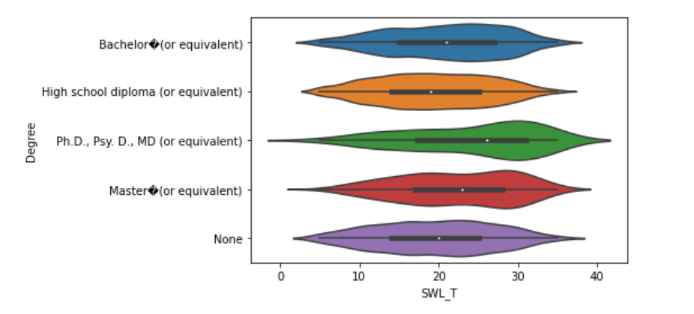
Education Vs Satisfaction with Life (SWL Test)
With respect to the SWL test, we can see that
A lower score in this test indicates a lower satisfaction in life.
The highest median value seems to be for the most educated in our analysis that is the participants who have completed a Ph.D followed by Masters.
Going further down, we can see the Bachelor and High School participants.
Overall we can see that satisfaction in life increases with the number of years spent on education.

Slide 27
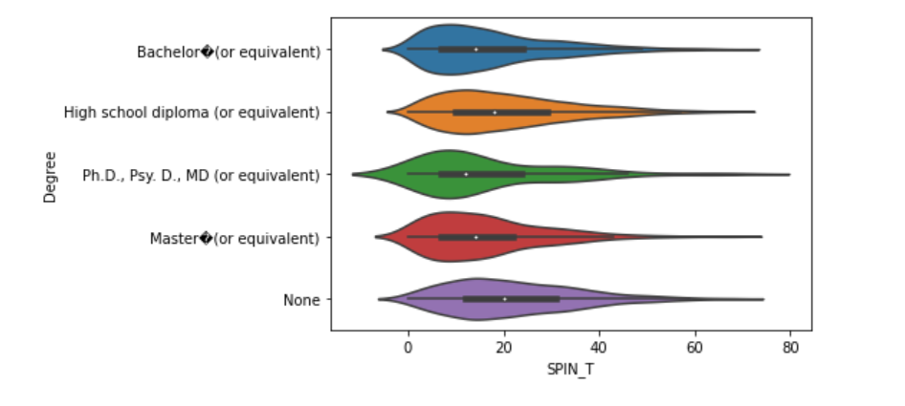
Education Vs Social Phobia Index (SPIN Test)
With respect to the SPIN test, we can see that
A lower score in this test means a lower level of social phobia.
The highest median value seems to be for the High school students again followed by the bachelor degree holders.
Masters and Ph.D holders have a better score in comparison with the former categories.
Overall we can see that Social phobia reduces as the number of years spent in education increases.

Slide 28
For the analysis we can see that, education helps a person grow more confident and surer of oneself making them less prone to the mental health issues discussed here.
Does the Employment/Work of the participant make a difference with respect to the mental health related problems explored in this dataset among Gamers?
We would expect that employed people are less prone to the mental health issues explored here, and that is correct. Find below a few plots to support this.

Slide 29
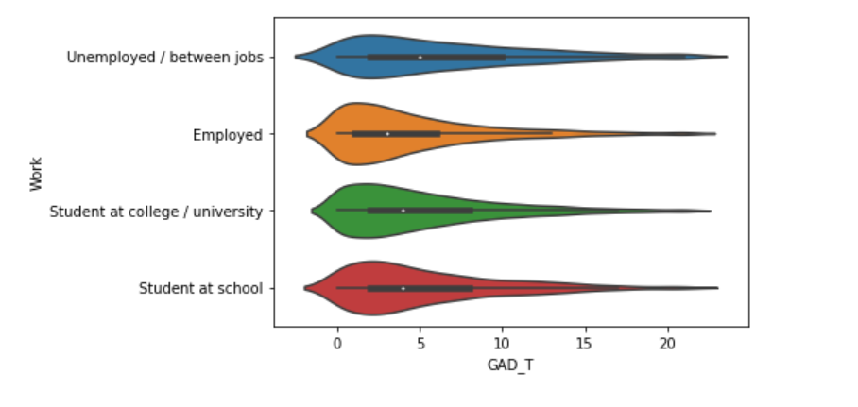
Work Vs Anxiety Severity (GAD - Test)
A high score in this test means high Anxiety and guess what, the unemployed are at the top,
The Unemployed participants have a much higher media and 75th percentile value comparing all the other categories making them the most prone to Anxiety.
Also, the neck of this violin for the unemployed is much larger than that of the others, meaning a higher percentage of people are experiencing high anxiety.
The students (School and College) have clustered together in this plot, their plots look identical, better than the unemployed.
Employed participants seem to have a much lower value on all fronts.

Slide 30
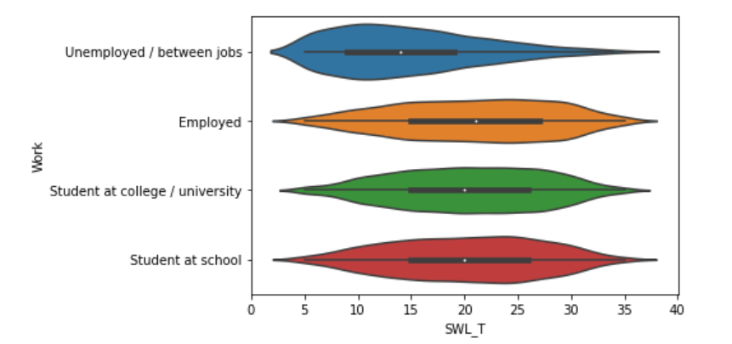
Work Vs Satisfaction with Life (SWL - Test)
A high score here means a high satisfaction with life,
The plot shows a significant difference between the unemployed and all the other categories.
It is to be noted that the median of the unemployed (50th percentile) is slightly lower than the 25th percentile of all the other categories.
Similar to the previous plots the Students (School and College) can be grouped together, they have nearly identical plots
Finally the employed have a slightly better value than the students with respect to the median and the 75th percentile on the satisfaction metric.

Slide 31
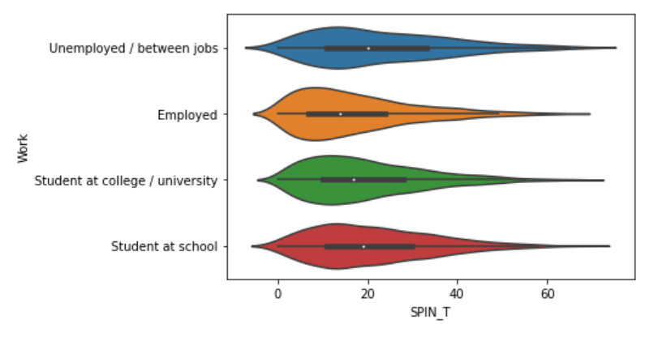
Work Vs Social Phobia Index (SPIN Test)
A High score in this test would mean a higher social phobia, the plot is very similar to the other two that we have seen. Unemployed participants seem to have the worst score and the employed participants have the most confidence to battle social phobia.
From this we can clearly that employment provides a person with confidence and mental strength to battle the mental health related issues discussed. Another point to take away from this is to be kind to the unemployed and assist them. We need to refrain from being hurtful because they are clearly in a lot of Pain, stress and anxiety already.

Slide 32
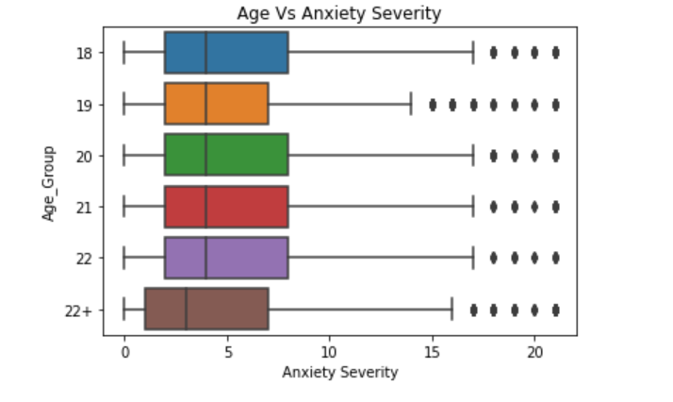
Does the Age of the participant make a difference with respect to the mental health related problems explored in this dataset among Gamers?
The age groups who attended this survey were majorly between 18 to 22 , so we have clustered all greater values into one group.
Age Vs Anxiety Severity (GAD Test)
With respect to Anxiety, the median for the age groups between 10 to 22 looks like a straight line. Not much difference between them that is worth noting.
But for the age groups greater than 22, the 25th Median and 75th percentile are much better than the others.

Slide 33
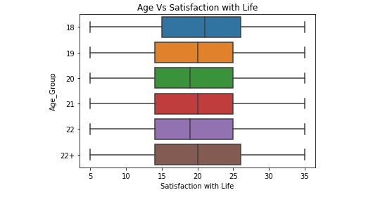
Age Vs Satisfaction with life (SWL Test)
With respect to the satisfaction in life we do not see any patterns that can be explained, just with age we cannot ensure that the satisfaction in life would increase.

Slide 34
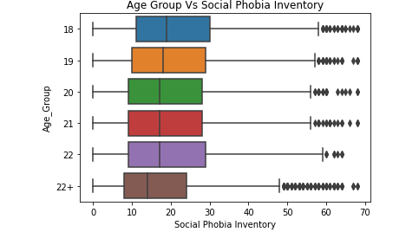
Age Vs Social Phobia Index (SPIN Test)
Considering social phobia, with age we can see that the median slowly decreases. We can interpret from this that the feeling of social phobia decreases as time progresses.
One take away from this analysis is that the younger groups seem to be more prone to the feelings of social phobia and anxiety, but with time they grasp the concept of coping with these feeling.

Slide 35
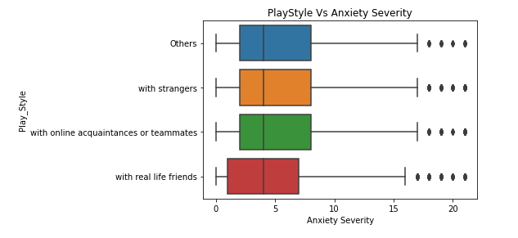
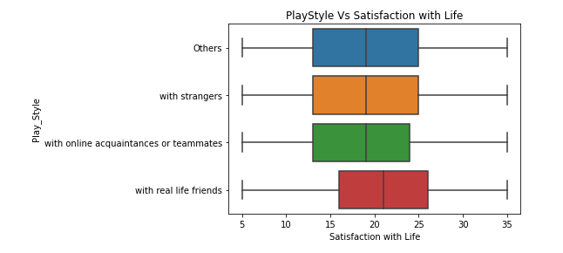
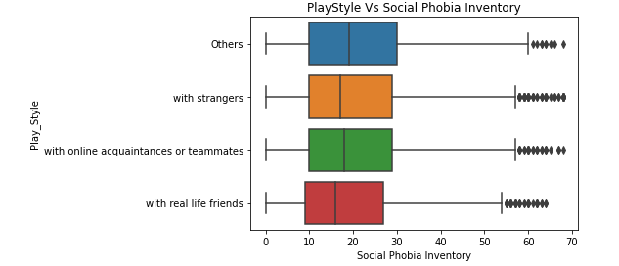
4) What is the relationship between Playstyle and the feeling of social phobia, anxiety & depression among Gamers?​

Slide 36
From the above 3 plots we can see that,
Considering Anxiety severity even though the median is the same for all the 4 categories, the 25th and the 75th percentile have a lower values than the others, when one plays the game with real life friends
The same is more evident in the Satisfaction where playing with real life friends has increased the life satisfaction significantly.
Similarly people who play with real life friends are less affected by the feeling of social phobia, from the plot we can see that the median is lesser compared to the other categories.
From this we can infer that playing with real life friends improves the overall mental health of a person.

Slide 37
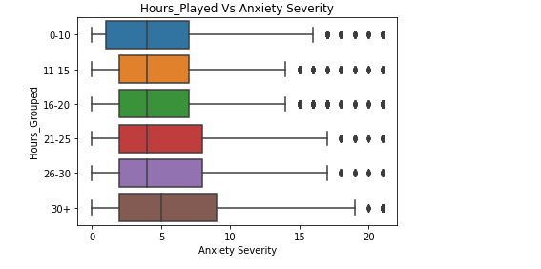
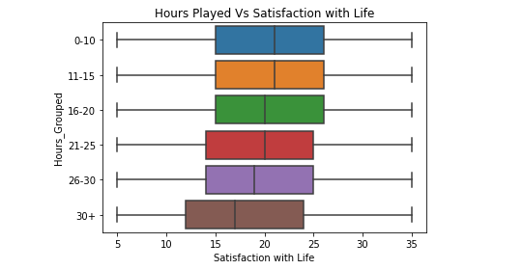
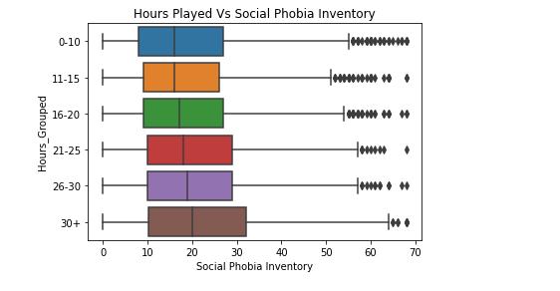
5) What is the relationship between number of hours a video game is played and the feeling of social phobia, anxiety & depression?

Slide 38
All three plot show one trend in common; we can see that with increase in the number of hours spent playing video games, the issues related to mental health substantially increases.
The sweet spot lies between 10 to 25 hours after which we see a drastic dip in Life satisfaction and increase in social phobia and anxiety.
A key takeaway for people in authority would be to regulate the time spent playing video games to this number to make sure the person has better mental health.

Slide 39
CONCLUSION AND RECOMMENDATION:
Overall trend that we have analyzed from this dataset is that younger people are most vulnerable to effect of the mental health issues discussed in here.
With adults having more education or a stable employment helps combat these disorders.
In conclusion, young adults will have to be taught on how to regulate the time they have between productive and fun tasks like gaming to have an overall better life satisfaction and have good mental health.
Another interesting insight from the analysis is that playing games with real life friends seem to provide a better resistance to the disorders discussed implying that improving ones social skills and acquiring friends goes a long way in creating a better life experience.

Slide 40


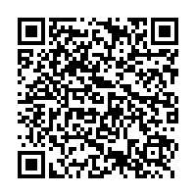
Links
GitHub:
https://github.com/kevin141997/DAB-103
Tableau Dashboard:
https://public.tableau.com/views/GamingData-Proj103/PlayStyle?:language=en-US&publish=yes&:display_count=n&:origin=viz_share_link

